Slide 1
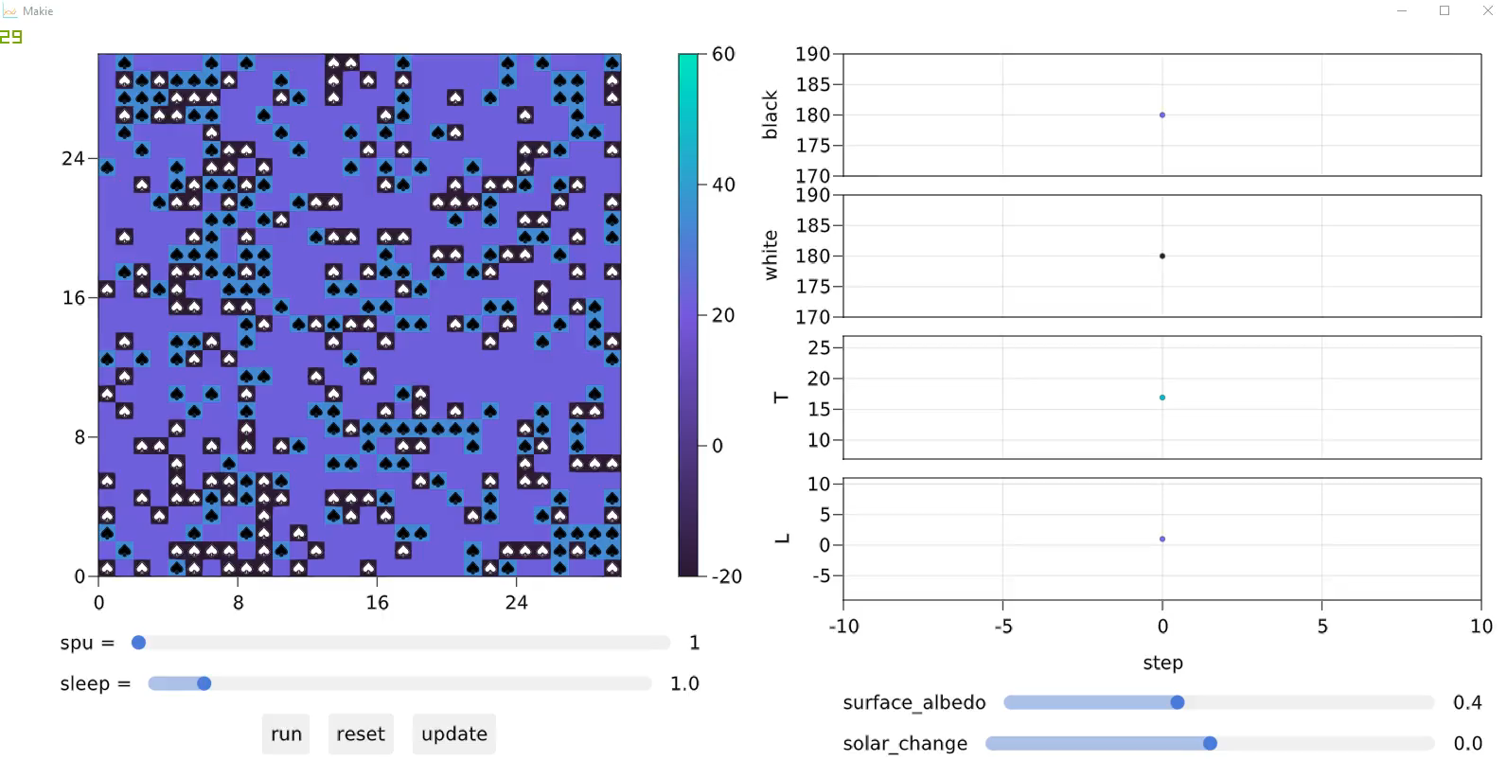
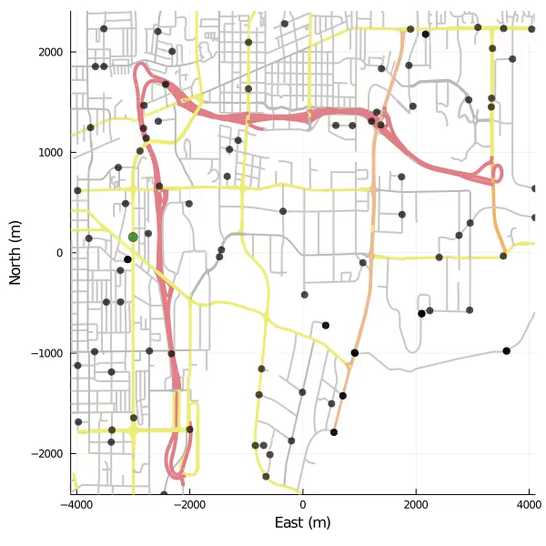
Agents.jl logo is an SIR (virus spreading) simulation in a continuous space
Interactive app with the Daisyworld simulation in discrete space
a zombie outbreak simulation on an Open Street Map
Notes:
Welcome! In this workshop we will be going through Agents.jl, which is an open source Julia framework for agent based modelling.

Slide 2
Feature-full
All standard functionality
Four kinds of spaces
Flexible data collection, parameter scanning, check-pointing
Multi-agent support
Many more…¹
Simple
Harmonious, general API
Little lines of code, short learning curve
Simpler than NetLogo, Mesa, …²
Performant
Written purely in Julia, has been optimized
Allows for distributed computing
Faster than NetLogo, Mesa, …²
Interactive
Julia is dynamic, Agents.jl is as well
Visualizations & interactive applications
API is extendable and adaptable
Integrated
Integrates with the entire Julia ecosystem
Main output is a DataFrame
Integrations with DifferentialEquations.jl, LightGraphs.jl, BlackBoxOptim.jl, …¹
[1] docs: https://juliadynamics.github.io/Agents.jl/stable/
[2] paper: https://arxiv.org/abs/2101.10072
Notes:
Why would you use Agents.jl? Well, in this slide I am highlighting the 5 central properties of Agents.jl.

Slide 3
Session 1 exercises
Introduce third group to the Schelling model. Re-initialize the model with N agents, having N/3 agents of each type. Animate the model evolution using abm_play so that each agent group is plotted with a different color and marker.
Continue with the Schelling model. Introduce a agent property stationary that counts how many steps has an agent remained in the same location. Then, collect agent happiness only for agents that are stationary for x steps.
Modify the model properties to have a dictionary that maps agent group to a "segregation" counter, an integer. Then create a model_step! function that at its start it sets all segregations to 0. Then, it loops over agents. Each agent that has all 8 neighbors be of the same group, increments their group segregation property by 1.
Then, use run! to collect model data. Specifically, collect the segregation counter of each group as an individual column of the output dataframe. Plot each segregation curve versus the step number, using the same colors you used to plot agents in abm_play.
Where can I get support for Agents.jl? (1) read online documentation, (2) chat with us in the channel #dynamics-bridged in the Julia Slack: https://julialang.org/slack/ , (3) post a question in the Julia discourse: https://discourse.julialang.org/ in the category “Modelling and simulations”, using “agent” as a tag!

Slide 4
Session 2 exercises – part 1: Extensions of the Schoolyard example
Modify the agent_step! function so that the new_pos variable is clamped into the size of the schoolyard (the continuous space), because if the new_pos exceeds the limits of a space an error is thrown. Hint: what’s size(model.space) ?
Modify the schoolyard function so that students have not just one friend and one foe, but 8 of each.
Modify the agent_step! function such that the force value of each loop in the social network adherence section takes into account not only buddiness, but also class. The schoolyard function could pass in two additional keyword arguments: a_force = 0.5 and b_force = -0.5 to store as model properties for example. Update the sliders dictionary such that a_force and b_force can be altered in the data exploration window.
Session 2 exercises – part 2: Create a new ABM from scratch!
Implement a rock-paper-scissors model. Agents exist on an MxM square grid, and have a type property which can be one of: :rock, :paper, :scissors. Populate the grid randomly with N < M^2 agents (1/3 of each kind). Use a random scheduler. The model dynamics are as follows: each agent first pick a random nearby position (use distance with 4 neighbors). Then, they roll a three-sided dice and perform one of the following 3 actions:
Fight: Fight your neighbor according to the rules of rock-paper-scissors. The loser is killed with kill_agent!. Do nothing if the chosen position is empty or if there is a tie.
Reproduce: If the chosen position is empty, it becomes a new agent with same type via add_agent!.
Move: Move to the nearby position using move_agent!. If another agent was already there, that agent moves to the first agent’s original position (that has been left empty).

